Slide 1
Web Development
Lesson 7:
Deploying Node.js Web Applications to Azure

Slide 2
Topics
Creating an Azure Site
Azure Deployment
Azure CLI

Slide 3
Objectives
By the end of this lesson you should be able to:
Create an Azure Site
Understand Azure Deployment using Git
Interact with the Azure CLI

Slide 4
Problem: Hosting a Web App
Need to buy hardware
Need to configure and set up instances
Need to monitor
Need to repeat each time you need to scale (~few days to few months)
Notes:
Notes:
The problem with hosting yourself is that you need to do all this things and then turn around time is slow
The faster you can deliver the more advantage you’ll have with your products.
Solution is to use cloud computing
References:
https://www.salesforce.com/uk/blog/2015/11/why-move-to-the-cloud-10-benefits-of-cloud-computing.html

Slide 5
Azure Cloud Computing
Virtual Machines
Cloud Services
App Services
Service Fabric
Azure Functions
Notes:
Notes:
VM is IaaS. It's like buying a house.
Cloud services are like renting a house (PaaS).
App services are like staying in a hotel (light PaaS). This lesson uses App services.
Alternatives to Azure are AWS, Rackspace, Google and others.
References:
https://azure.microsoft.com/en-us/documentation/articles/fundamentals-introduction-to-azure/
https://azure.microsoft.com/en-us/services/functions/
https://azure.microsoft.com/en-us/documentation/services/app-service/
https://azure.microsoft.com/en-us/documentation/services/cloud-services/
https://azure.microsoft.com/en-us/documentation/services/virtual-machines/

Slide 6
Node and npm
node -v
npm –v
//Download Azure CLI:
npm i -g azure-cli@0.10.1
Notes:
Notes:
This lesson requires Node 6.2.0 or 6.x and npm v 3.8.9 or 3.x.

Slide 7
Azure Login
azure login
Copy URL and open in browser
Enter code from the terminal
Login on the webpage
Notes:
Notes:
Azure will need package.json to run npm install on the server.
Students should use npm init to create a new package.json in their project folder.

Slide 8
Deployment Checklist
package.json with all dependencies
package.json with the correct exact versions
Prepare production API keys / databases / other cloud accounts
Git and Azure account (with SSH keys)
Notes:
Notes:
This is the checklist which will help to prepare code for deployment to Azure.
Having exact versions is better because it will prevent conflicts if a dependency is updated.
API key must go into environment variables, not source code.

Slide 9
Hello World
/nodejs-express-hello-world-app
.git
node_modules
.gitignore
package.json
server.js
Notes:
Notes:
node_modules won't be committed to git or pushed to cloud because Azure needs to build dependencies in the cloud.
It will use info from package.json.

Slide 10
Hello World package.json
{
"name": "lesson8",
"version": "1.0.0",
"description": "",
"main": "server.js",
"scripts": {
"test": "echo \"Error: no test specified\" && exit 1"
},
"engines": {
"node": "6.1.0"
},
"author": "Azat Mardan",
"license": "ISC",
"dependencies": {
"express": "^4.13.4"
}
}
Notes:
Notes:
This file can be found in Module 2/code/lesson8/nodejs-express-hello-world-app/package.json
It uses Node 6.1, which has support for most of ES6 features.
Express is also used.

Slide 11
Create Hello World Node App
let express = require('express')
let app = express()
let port = process.env.port || 3000
app.all('*', (req, res)=>{
console.log('Working in ', process.env.NODE_ENV)
console.log(`${req.method} ${req.url}`)
res.send('Hello World')
})
app.listen(port)
Notes:
Node:
This file can be found in Module 2/code/lesson8/nodejs-express-hello-world-app/server.js
Using port from env var is important. Later, Azure storage keys from env vars will be used.

Slide 12
Create Azure Site
azure site create {appname} --git
The above command creates the site at the following URL:
http://{appname}.azurewebsites.net
Notes:
Notes:
Students should execute this command from their project folder.
Pick a unique name.
Choose location.
If Git/FTP deployment credentials have not been set up for their Azure subscription, they will also be prompted to create them.

Slide 13
Azure Site Create Example
azure site create hellojs2 --git
//Result:
info: Creating a new web site at hellojs2.azurewebsites.net
-info: Created website at hellojs2.azurewebsites.net
+
info: Executing `git init`
info: Initializing remote Azure repository
+ Updating site information
info: Remote azure repository initialized
+ Getting site information
+ Getting user information
info: Executing `git remote add azure https://azatazure@hellojs2.scm.azurewebsites.net/hellojs2.git`
info: A new remote, 'azure', has been added to your local git repository
info: Use git locally to make changes to your site, commit, and then use 'git push azure master' to deploy to Azure
info: site create command OK
Notes:
Notes:
This will create an Azure app by adding it to the cloud and adding git remotes to our local repository.

Slide 14
Sanity Check
ls -lah
git remote -v
Notes:
Notes:
Output should show both .git and .gitignore
The output of the second command should be the app name in the remote URL.
This is the destination for git push to deploy code.

Slide 15
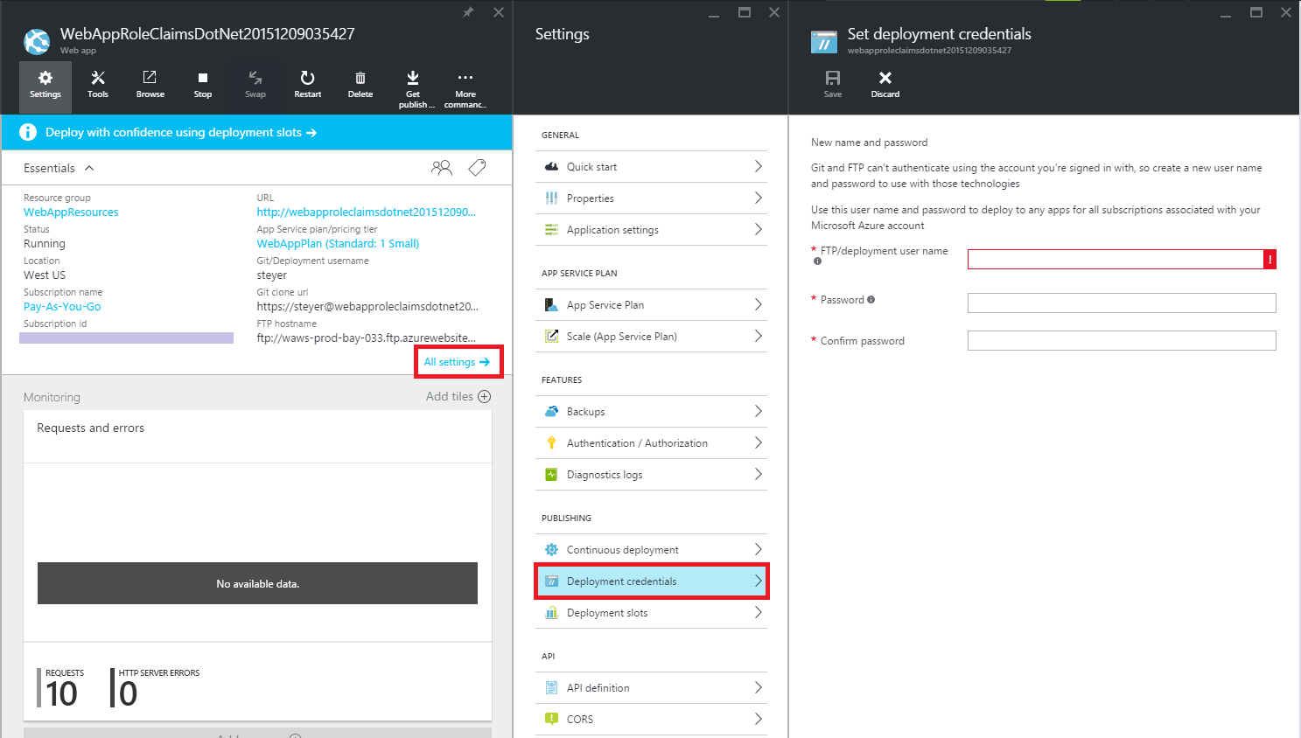
Azure Deploy Password
Notes:
Notes:
Students may need to reset their deploy password.
It is different from the Portal password.
GO to App Services -> Your App (hellojs2) ->Settings -> Publishing -> Deployment Credentials
OR App Services -> Your App (hellojs2) ->Settings -> General -> Quick Start -> Publish your app -> Reset deployment credentials -> Enter&Save
References:
https://acom.azurecomcdn.net/80C57D/cdn/mediahandler/docarticles/dpsmedia-prod/azure.microsoft.com/en-us/documentation/articles/web-sites-publish-source-control/20160415071221/includes/publishing-with-git/azure2-credentials.png

Slide 16
Deploying “Hello World” to Azure PaaS
For Windows Azure deployment, need a Git repository
To create it from the root of project, type the following command in the terminal:
$ git init
Notes:
Notes:
Skip this step if azure CLI created the Git local repository (and added remotes).
PaaS app services

Slide 17
Deploying to Windows Azure
In order to deploy "Hello World" application to Windows Azure, Git remote must be added.
Copy the URL from Windows Azure Portal, under Web Site, and use it with this command:
$ git remote add azure yourURL
Notes:
Notes:
Skip this step if azure CLI added remotes.
If name or appname is changed, this will need to be updated.

Slide 18
Adding Remotes Manually
$ git remote add azure URL
Use the following URL:
https://{username}@{appname}.scm.azurewebsites.net/{appname}2.git
Git will create a hidden .git folder.
Now add files and make the first commit:
$ git add .
$ git commit –am “first commit”
Notes:
Notes:
Use the username and password for deployment, NOT the Azure Portal credentials.

Slide 19
Push Code
Now code can be pushed using the following commands:
$ git push azure master
$ azure site browse
Notes:
Notes:
URL will be http://{appname}.azurewebsites.net/ for example http://hellojs2.azurewebsites.net/.
If everything went okay, there should be success logs in the terminal and "Hello World" in the browser of the Windows Azure Web Site URL.

Slide 20
Adding Changes
To add changes and re-deploy, use the following commands:
$ git add .
$ git commit -m "changing to hello azure"
$ git push azure master
Notes:
References:
A more meticulous guide can be found in the tutorial “Build and deploy a Node.js web site to Windows Azure” :
http://www.windowsazure.com/en-us/develop/nodejs/tutorials/create-a-website-(mac)).

Slide 21
Useful Azure CLI Commands
$ azure help site
$ azure site browse
$ azure site show
$ azure site start
$ azure site stop
$ azure site restart
$ azure site log tail
Notes:
References:
For more on Azure CLI:
https://azure.microsoft.com/en-us/documentation/articles/virtual-machines-command-line-tools/#commands-to-manage-your-web-apps
Debugging and configurations:
https://azure.microsoft.com/en-us/documentation/articles/app-service-web-nodejs-get-started/#debug-your-app-with-node-inspector

Slide 22
Putting Env Vars in the Cloud
azure site appsetting list
azure site appsetting add NODE_ENV=production
Notes:
Notes:
Add NODE_ENV production env var.
The result will be shown in logs which can be pulled with `azure site log tail`.
This is needed to access Azure storage.

Slide 23
Managing Scaling
$ azure site scale mode [options] <mode> [name]
$ azure site scale instances [options] <instances> [name]
Notes:
Notes:
You can easily scale your apps (add more power so to say) to handle more traffic.
Compare that to days or weeks when you’re not using cloud computing!!!
Modes: Free, Basic, Standard, or Premium modes.
You can use Portal as well.
References:
https://azure.microsoft.com/en-us/documentation/articles/web-sites-scale/
https://azure.microsoft.com/en-us/documentation/articles/virtual-machines-command-line-tools/#commands-to-manage-your-azure-cloud-services

Slide 24
Gulp and web.config
Walk through web.config and explain that it can be used for more advanced deployment of node apps:
lesson8/nodejs-express-hello-world-app
Notes:
References:
https://www.visualstudio.com/en-us/docs/build/apps/node/nodejs-to-azure

Slide 25
Managing Scaling
<configuration>
<system.webServer>
<!-- Visit http://blogs.msdn.com/b/windowsazure/archive/2013/11/14/introduction-to-websockets-on-windows-azure-web-sites.aspx for more information on WebSocket support -->
<webSocket enabled="false" />
<handlers>
<!-- Indicates that the server.js file is a node.js site to be handled by the iisnode module -->
<add name="iisnode" path="server.js" verb="*" modules="iisnode"/>
</handlers>
Notes:
Notes:
This is where the Node script name is configured.
lesson8/nodejs-express-hello-world-app/web.config
References:
You can also configure debug options: https://azure.microsoft.com/en-us/documentation/articles/web-sites-nodejs-debug/

Slide 26
Managing Scaling
var express = require('express');
var app = express();
var port = process.env.port || 1337
app.get('/', function (req, res) {
res.send('Hello World!');
});
var server = app.listen(port, function () {
var host = server.address().address;
var port = server.address().port;
console.log('Example app listening at http://%s:%s', host, port);
});
Notes:
Notes:
The Express server is using GET / route
lesson8/nodejs-express-hello-world-app/server.js

Slide 27
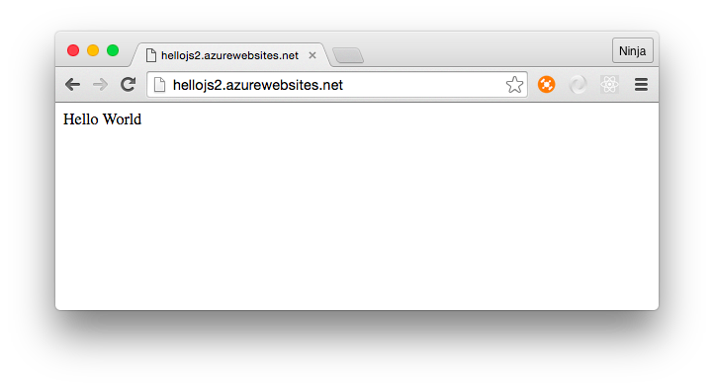
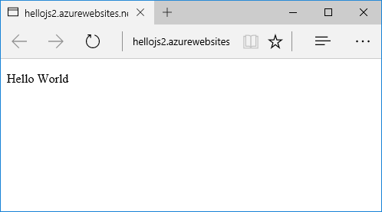
Hello World in Azure Example
http://hellojs2.azurewebsites.net/
Google Chrome
Microsoft Edge
Notes:
References:
https://www.visualstudio.com/en-us/docs/build/apps/node/nodejs-to-azure

Slide 28
Summary
In this lesson, you have learned:
To Create an Azure Site
Azure Deployment using Git
To interact with the Azure CLI
Notes:
Notes:
The Module 2 Lesson 8 Lab should be competed at this time
https://github.com/MSFTImagine/computerscience/blob/master/Complimentary%20Course%20Content/Module2/Labs/Module%202%20Lesson%208%20Lab.docx

